Slide 1
Central bank seminar US Rates Market
October 2025

Slide 2
Market Overview

Slide 3
Global Fixed income market outstanding
As of the end of 2024 the size of the global fixed income market exceeded $145tn growing by over $65tn over the 2013-2024 period
The size of the US part has grown to over $60.1tn
US accounts to 40.1% followed by EU 18% and China 17.1%
Source: BIS,SIFMA, September 2025

Slide 4
The debt versus Equity issuance
The pace of debt growth remains above the $20tn mark per annum
Global Long-term* Fixed Income Issuance ($Tn)
Global Equity Issuance ($Tn)
*Minimum maturity of 13 months
Source: Bloomberg, Refinitiv, Sifma, September 2025

Slide 5
US Rates market on Bloomberg

Slide 6
US Dollar Denominated debt
UST market remains the largest and the most liquid part of the global fixed income market
UST bonds account for more then half of the size (+$60tn)
Estimated average daily turnover in 2024 of $1.45tn
Source: BIS,SIFMA, September 2025
* Bills/Notes/Bonds/TIPS/FRNs

Slide 7
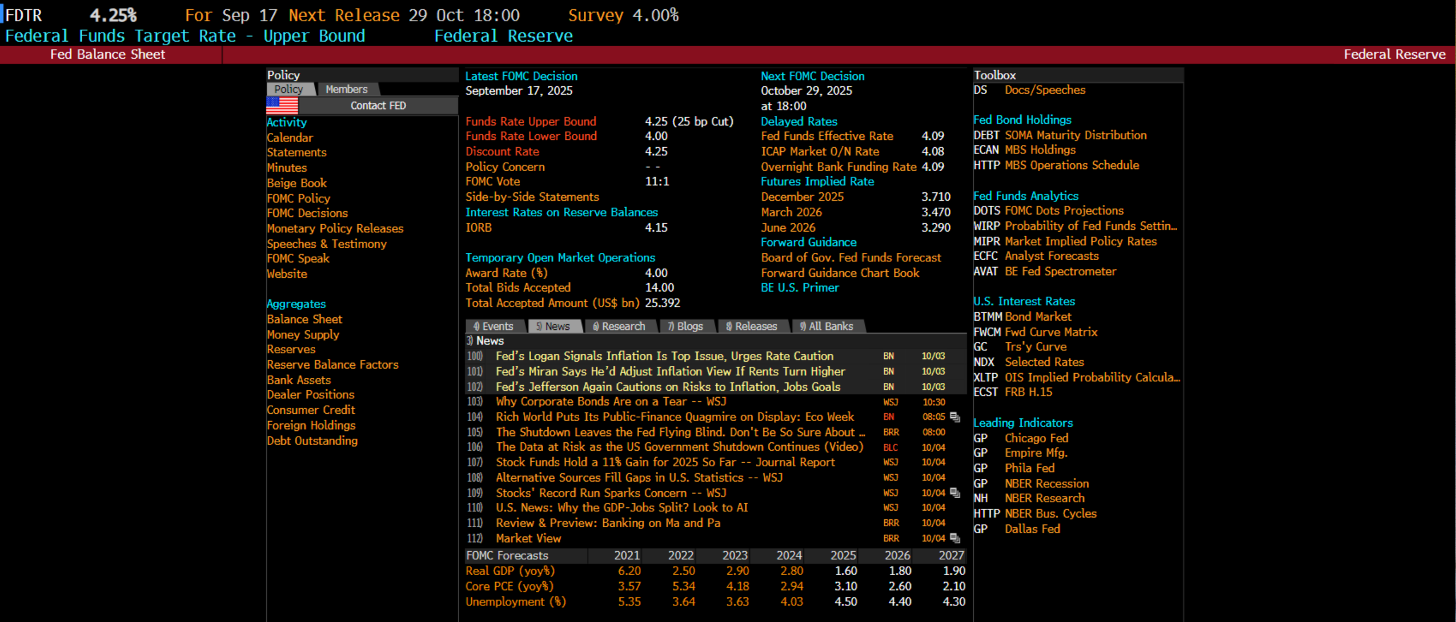
In Fed we trust
Since the Great Financial Crisis, many look at the FED as the Central Bank of Central Banks
Source: Bloomberg, CAIM, October 2025
*Bloomberg function ‘FED’

Slide 8
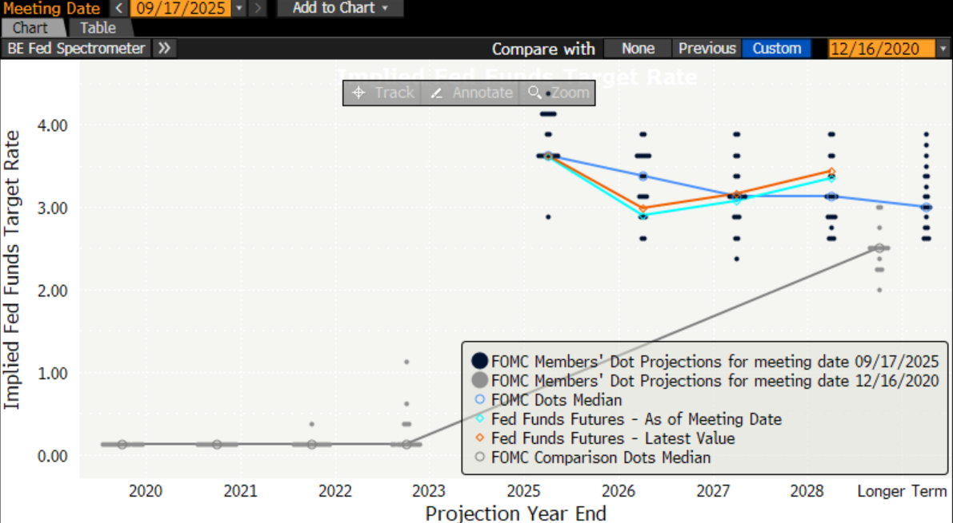
Fed forward ‘guidance’ tool
Since 2012 Fed officials started using the Dot Plot
Source: Bloomberg, CAIM, October 2025
*Bloomberg function ‘DOTS’

Slide 9
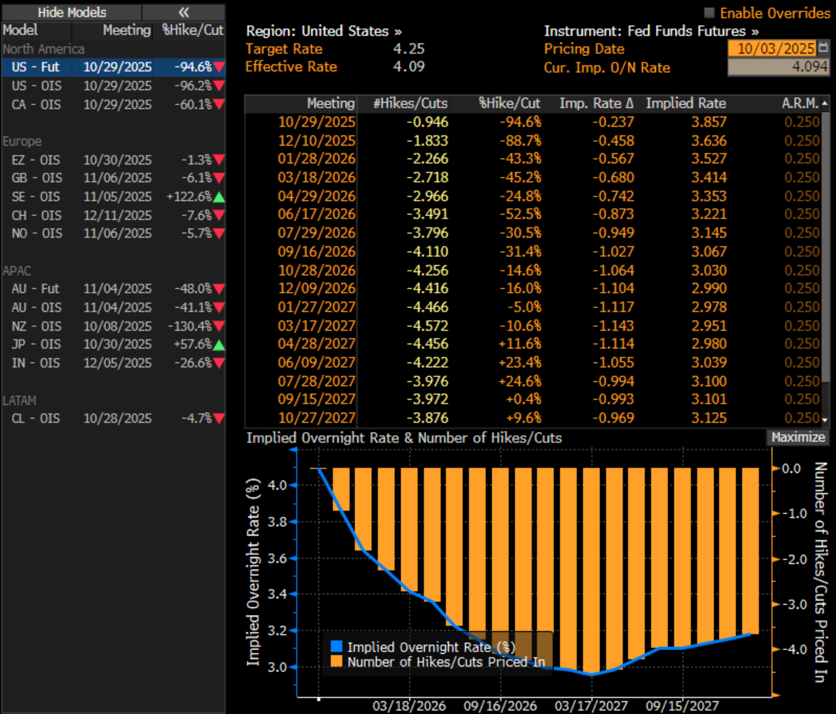
The Fed’s interest rate path*
It is an active curve - subject to market changes.
Source: Bloomberg, CAIM, , October 2025
*Bloomberg function ‘WIRP’

Slide 10
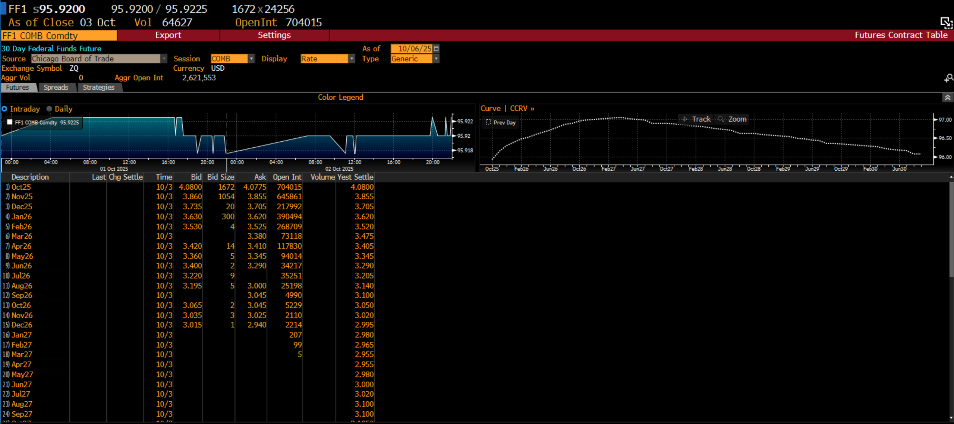
The ‘Fed’s’ curve*
A ‘crystal ball’ for the interest rate path
Fed Funds Futures liquidity dries quickly with time.
Source: Bloomberg, CAIM, , October 2025
*Bloomberg function ‘FFA Comdty CT’

Slide 11
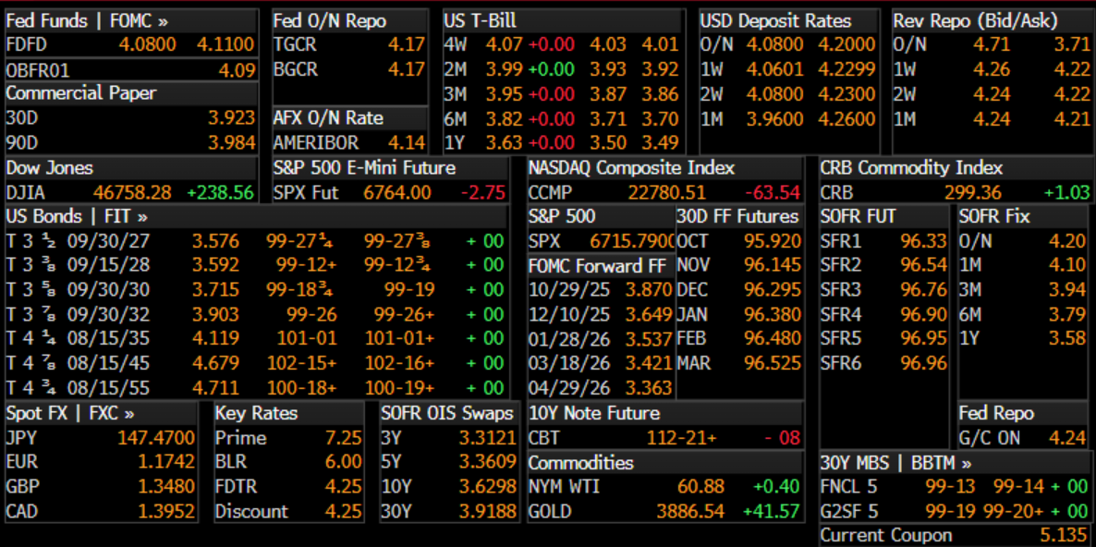
US Rates main monitor*
Some key market elements worth monitoring
Source: Bloomberg, CAIM, October 2025
*Bloomberg function ‘BTMM US’

Slide 12
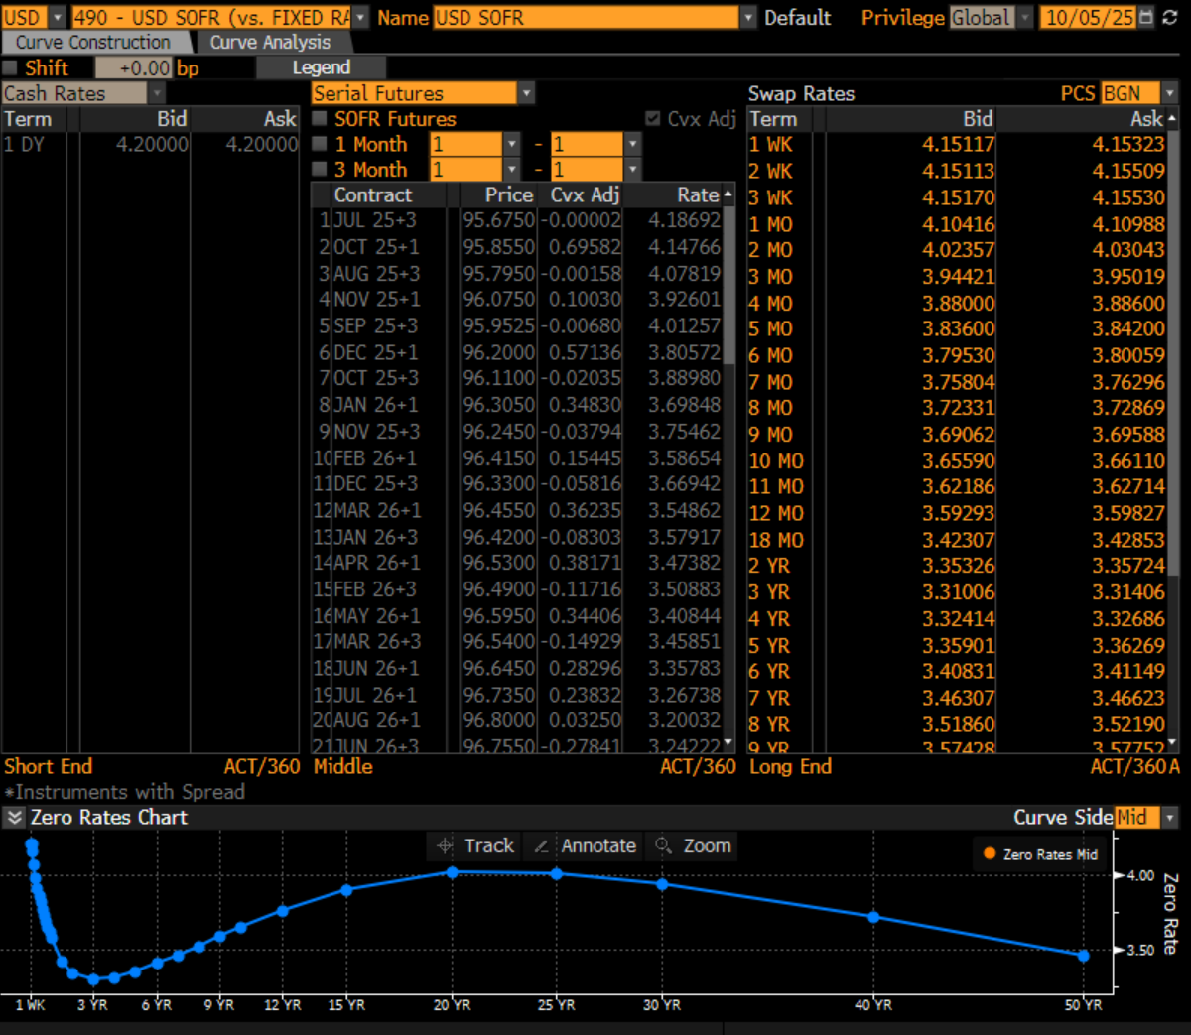
Libor is ‘dead’*
The SOFR is a new ‘tool’ to navigate through the US rates space
Source: Bloomberg, CAIM, , October 2025
*Bloomberg function ‘ICVS 490’

Slide 13
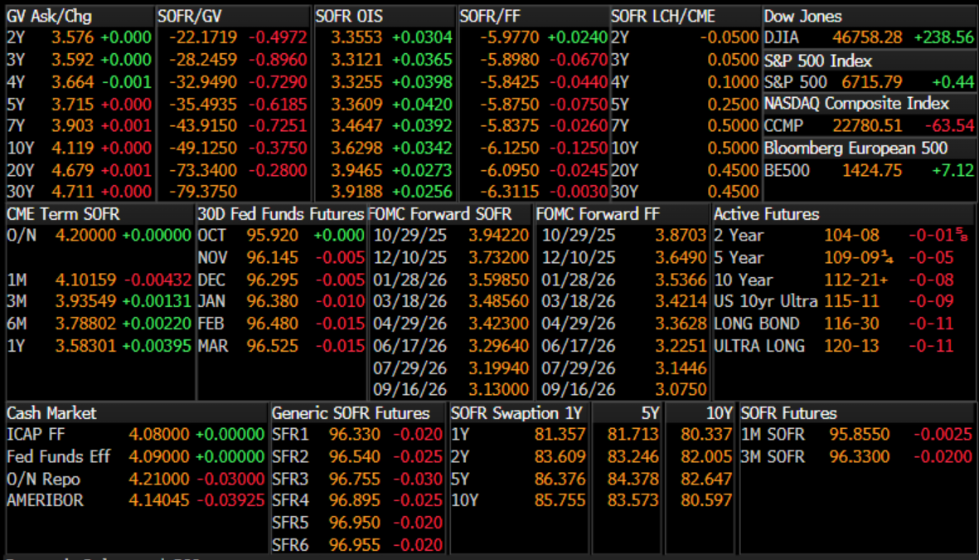
The SOFR is our new ‘Libor’*
Almost…
Source: Bloomberg, CAIM, , October 2025
*Bloomberg function ‘USSW’

Slide 14
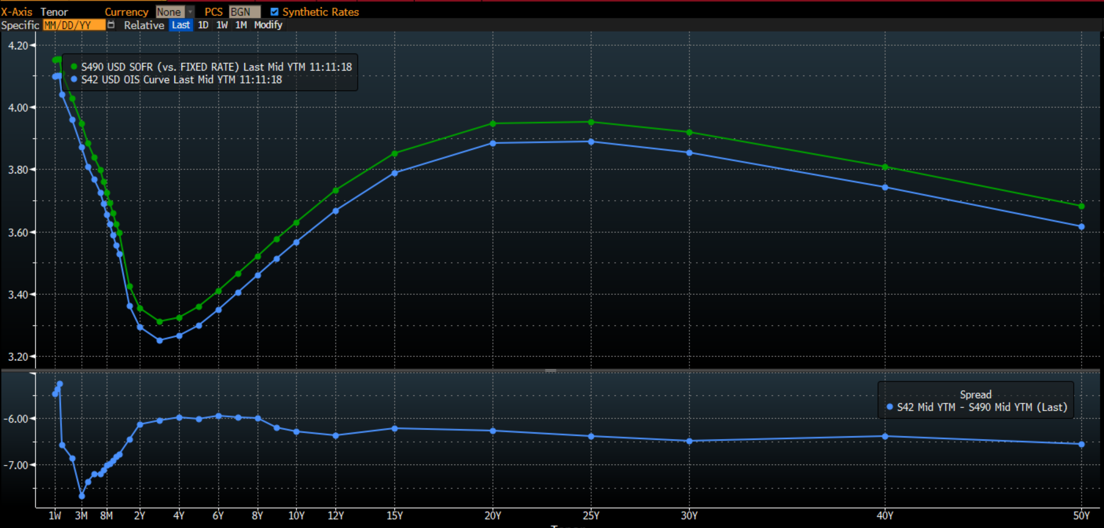
Secured versus unsecured risk
Disturbance of demand/supply forces
Source: Bloomberg, CAIM, , October 2025
*Bloomberg function ‘GC’

Slide 15
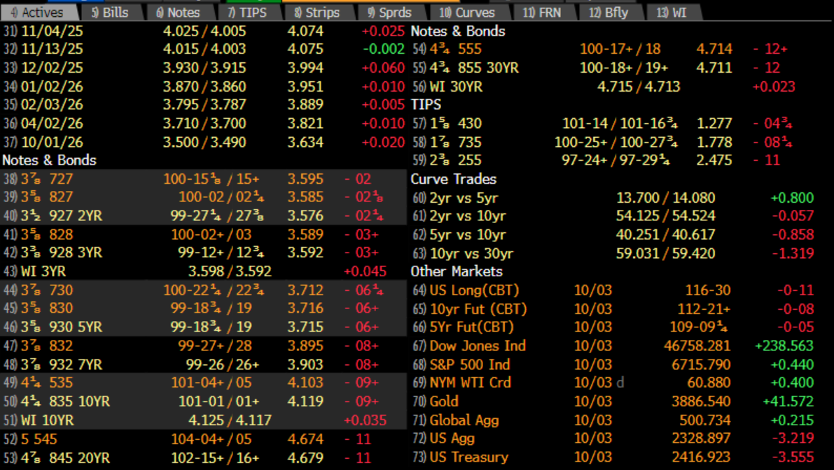
UST active monitor*
Liquidity does matter
Source: Bloomberg, CAIM, , October 2025
*Bloomberg function ‘FIT’

Slide 16
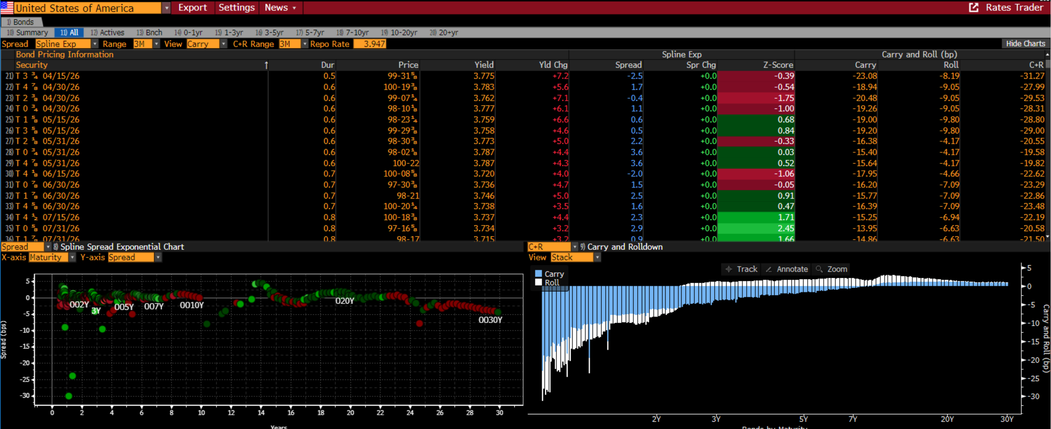
US Treasuries*
What is cheap and what is dear?
The curve normalisation process is almost finished.
Source: Bloomberg, CAIM, , October 2025
*Bloomberg function ‘GOVY’

Slide 17
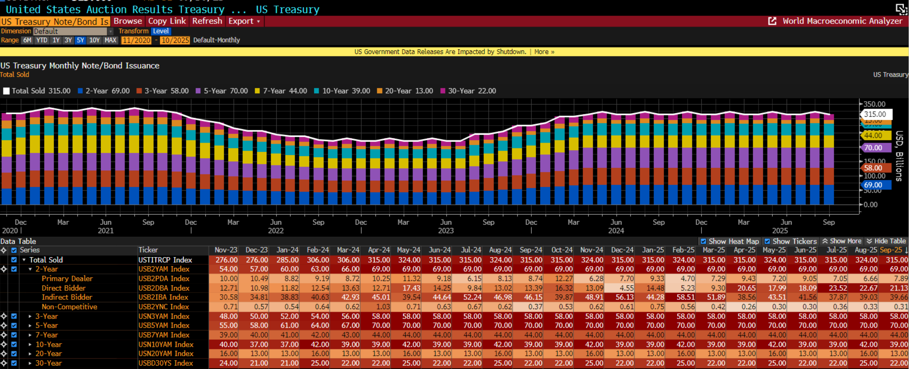
UST market growth
Market is closely watching the issuance calendar and results!
Source: Bloomberg, CAIM, , October 2025
*Bloomberg function ‘ECAN’

Slide 18
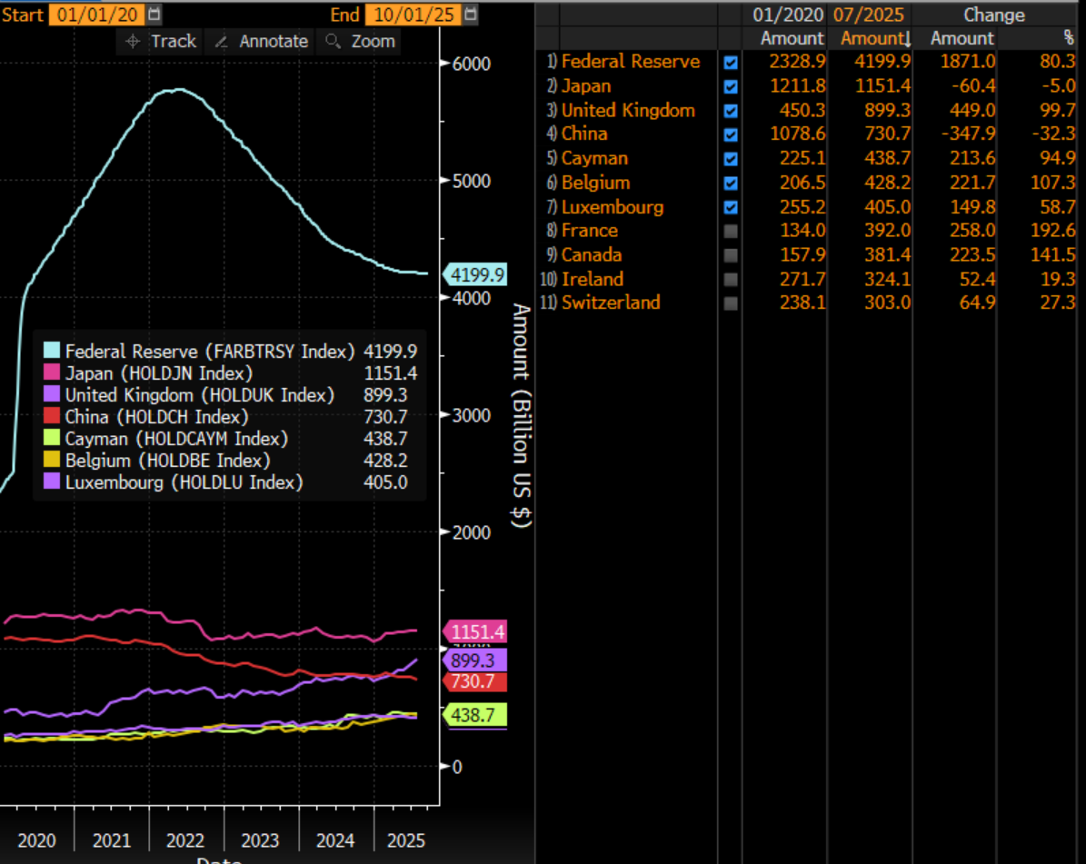
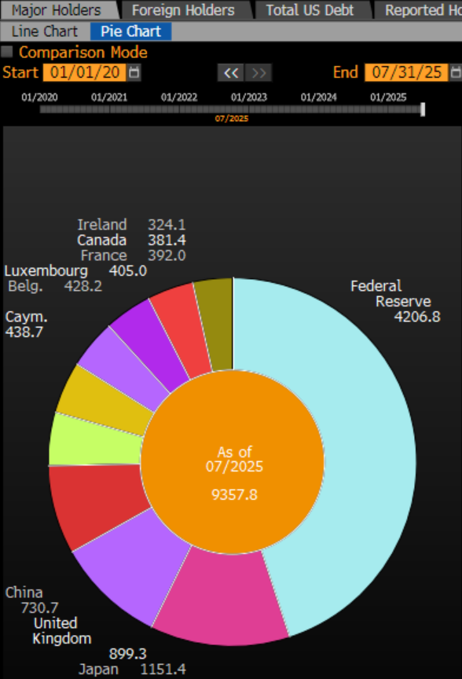
UST ownership structure
The FED has remained the single largest investor
Source: Bloomberg, CAIM, , October 2025
*Bloomberg function ‘DEBT’

Slide 19
Appendix

Slide 20
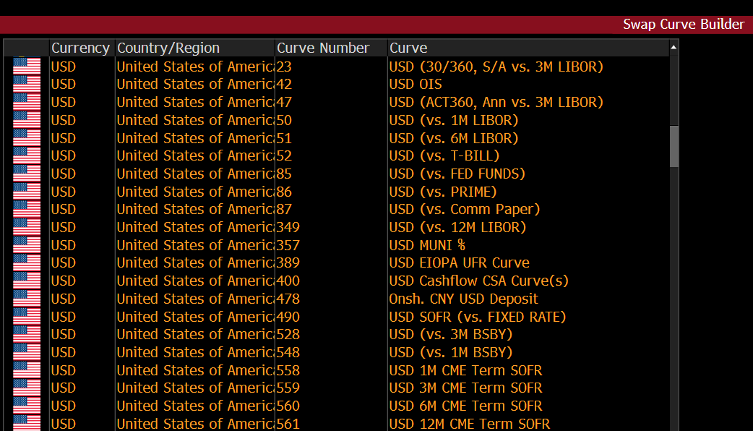
US Curves on Bloomberg
The lucky numbers are : 490 & 42!
Source: Bloomberg, CAIM, , October 2025
*Bloomberg function ‘ICVS’

Slide 21
Liquidity shift – one sided market
Market closely monitoring cash levels at the FED
Funds ‘parked’ at the Fed going dangerously low while Money Market funds enjoy wave after wave of inflows
Source: Bloomberg Finance L.P., August 2025

Slide 22
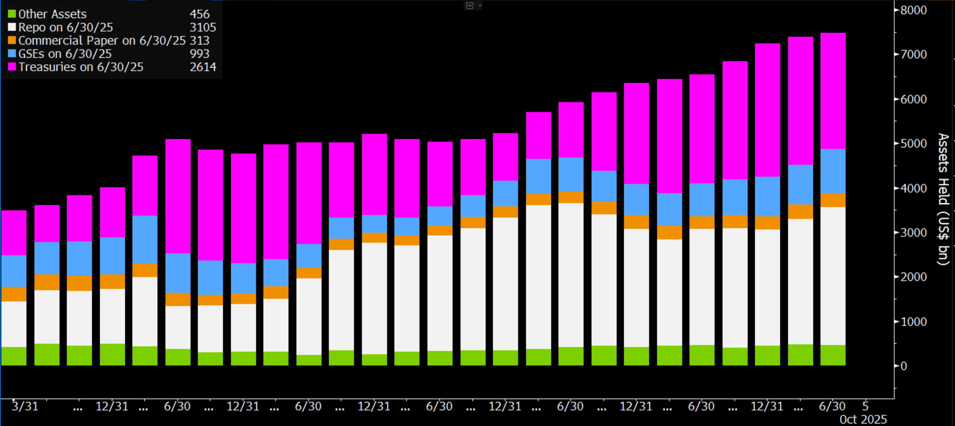
Money Market funds
Money Market steady inflows cannot last forever
Money Market funds flows behaviour remains one of the key questions in coming months
Source: Bloomberg Finance L.P., October 2025

